Slide 1

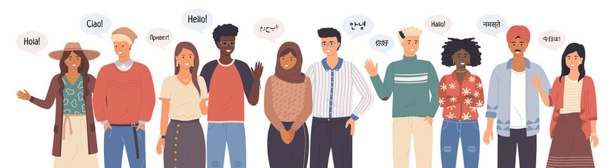

Module 2.1
Module Overview - Understanding Language
Living and Working with Artificial Intelligence
Unit 2
Understanding
Language
Developed for the AI4GA (Artificial Intelligence for Georgia) project funded by National Science Foundation awards DRL-2049029 and DRL-2048502.
This work is licensed under the Creative Commons. Attribution-NonCommercial-ShareAlike 4.0 International License. https://creativecommons.org/licenses/by-nc-sa/4.0/

Slide 2
Learning Objectives
Students should be able to:
List various ways in which they or people around them use language to interact with computers in their daily lives.
Distinguish concepts such as speech recognition, speech generation, and question answering.

Slide 3

How do computers interact with humans using language?
Think Pair Share (TPS) - Discussion
Notes:
Possible Student responses - speech recognition, text generation,queries

Slide 4

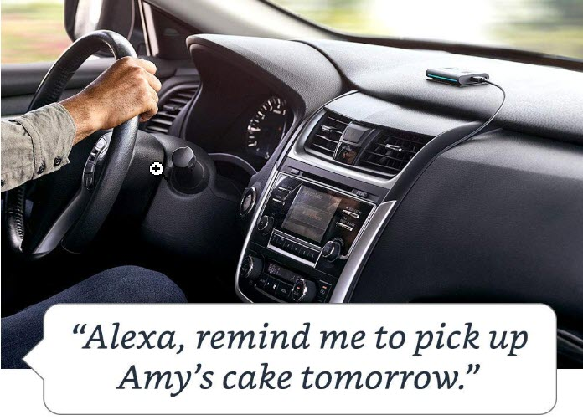
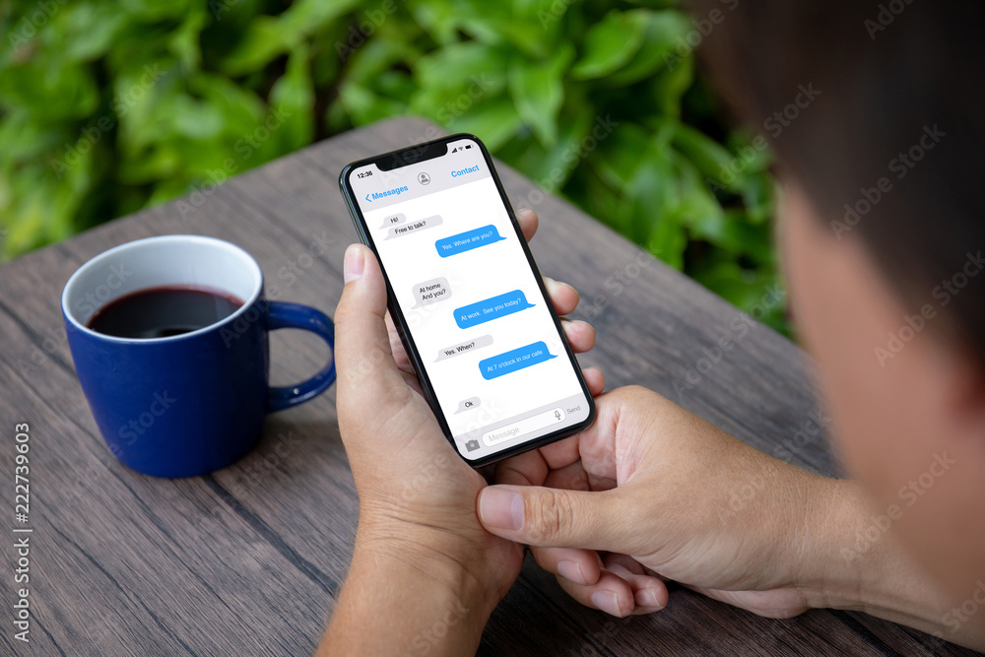

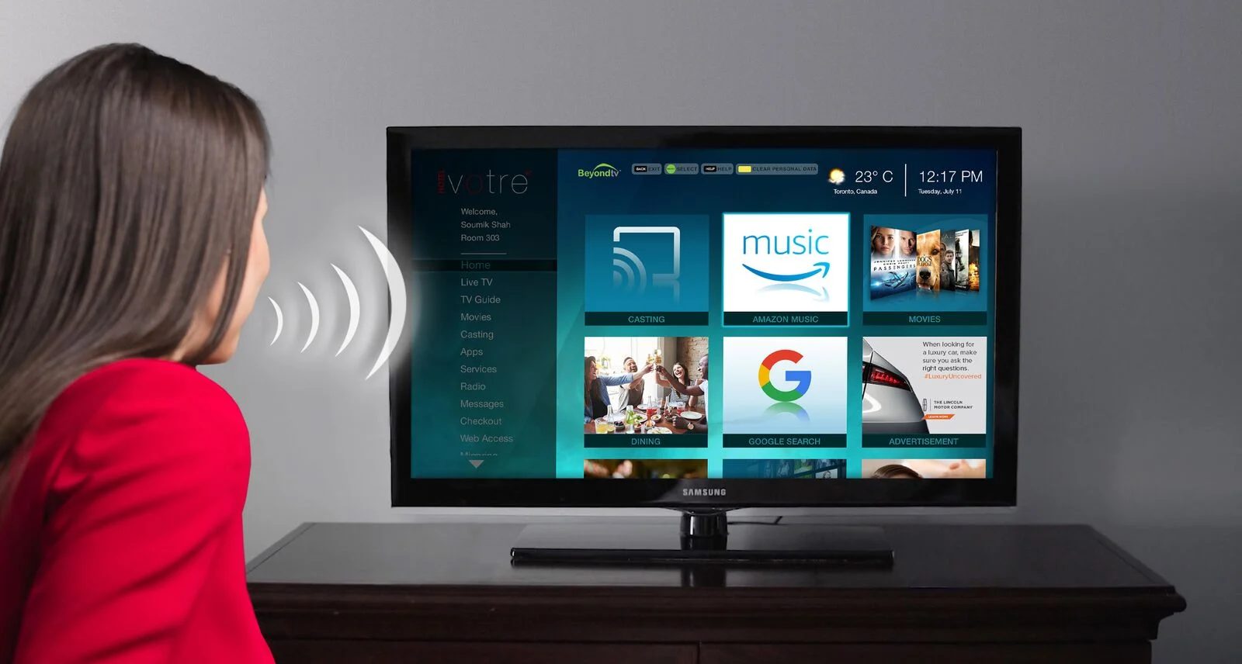
Speech to Text
Speech Recognition
Siri, Alexa, Google Intelligent Assistants
Smart TV Voice Commands

Slide 5
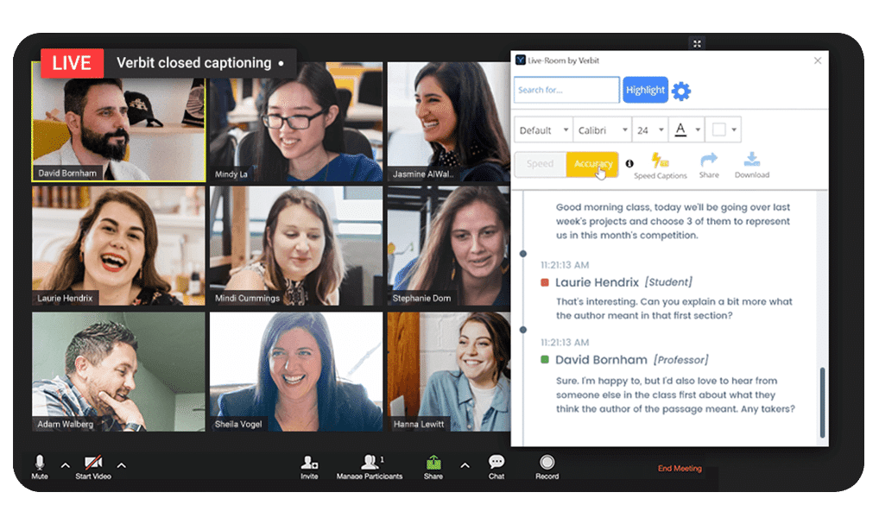

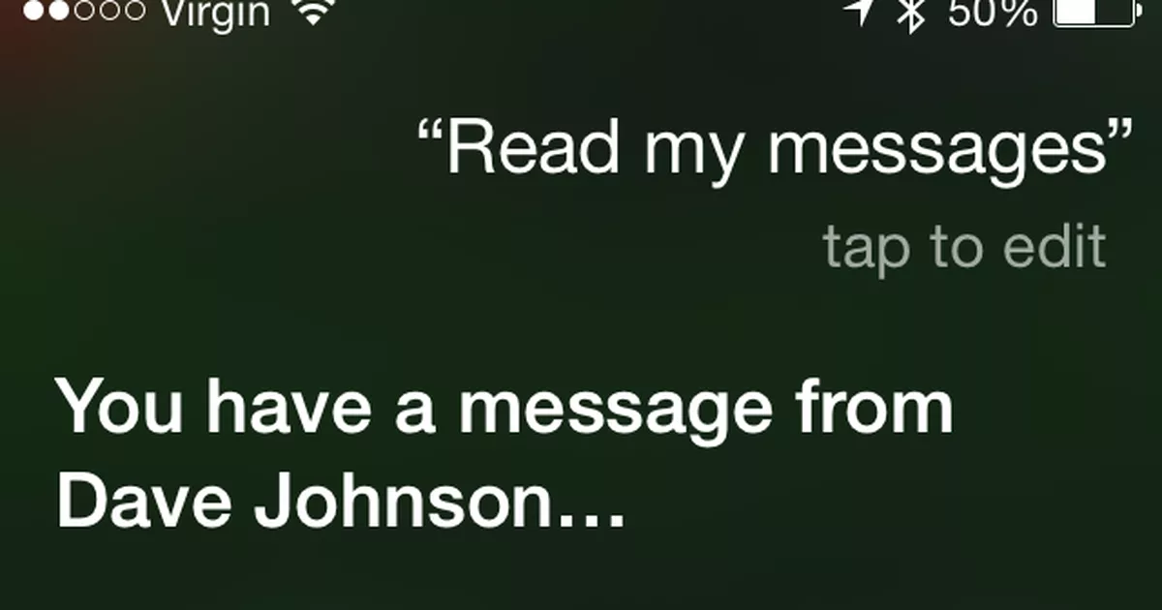
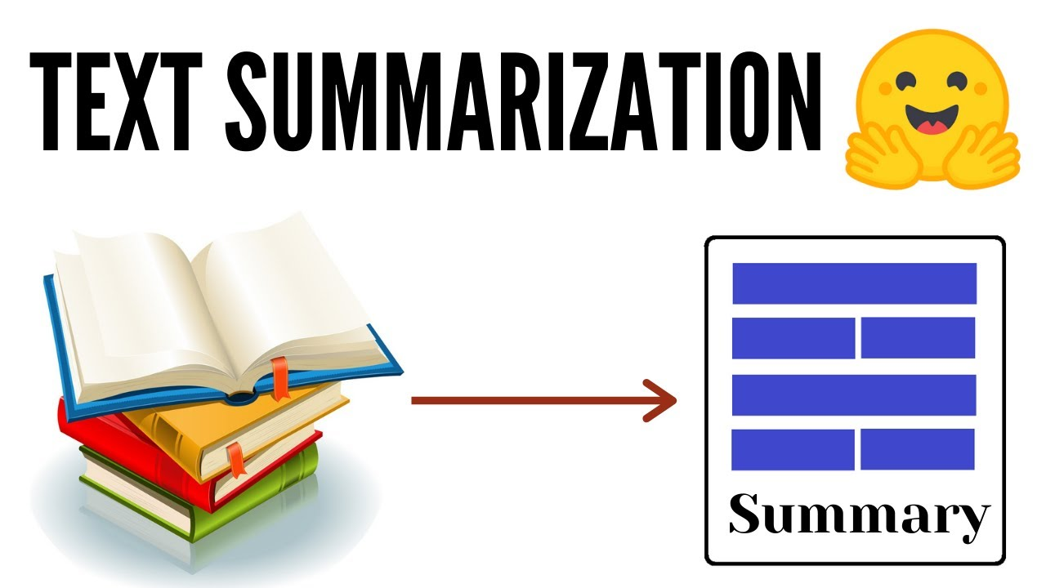
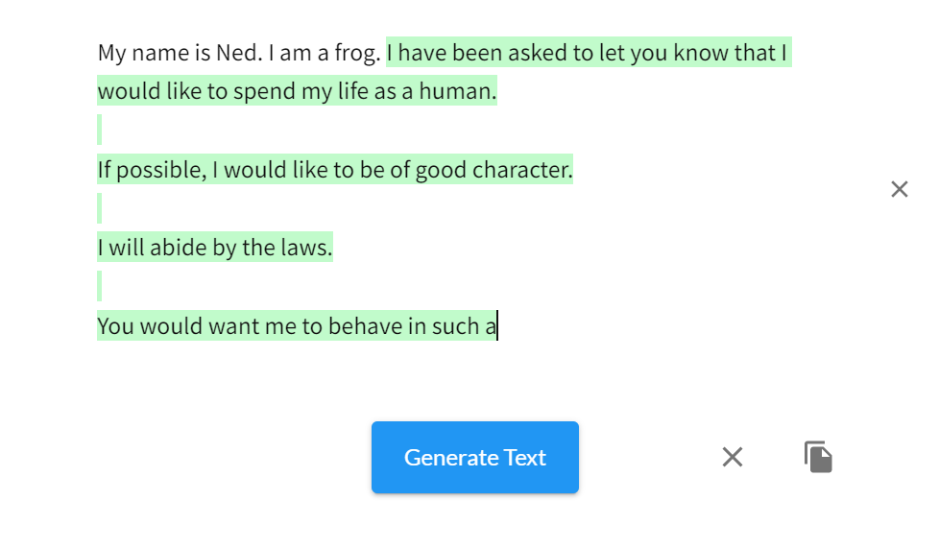
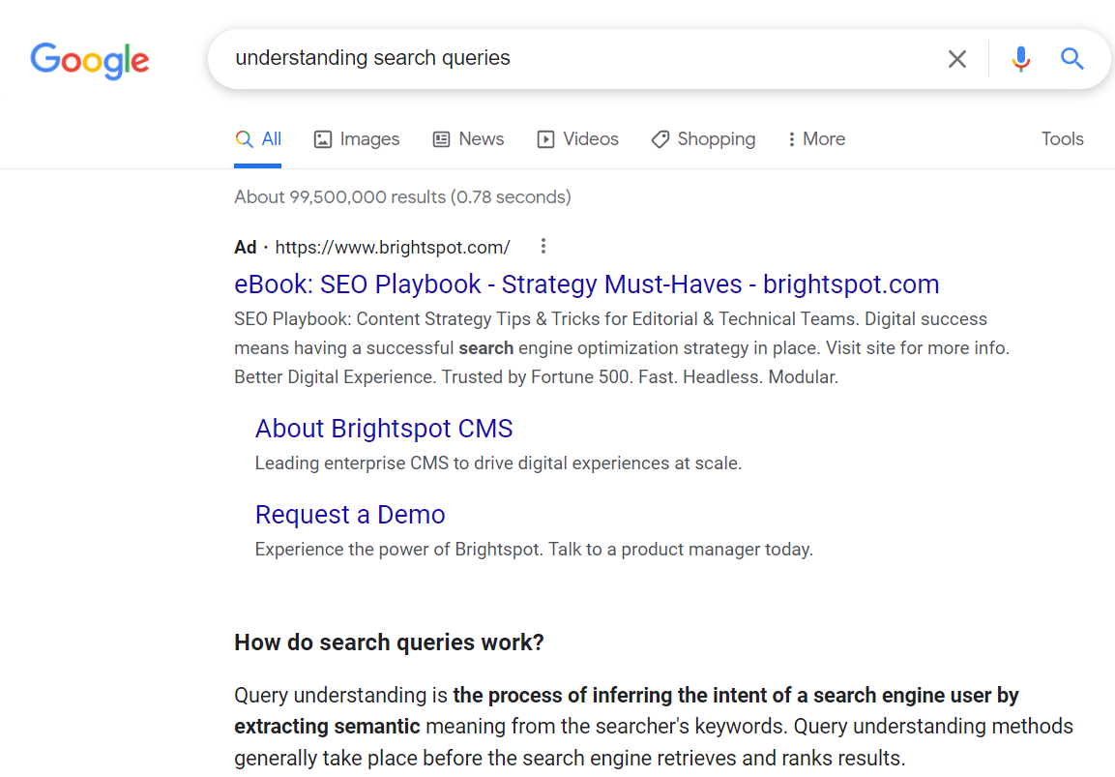
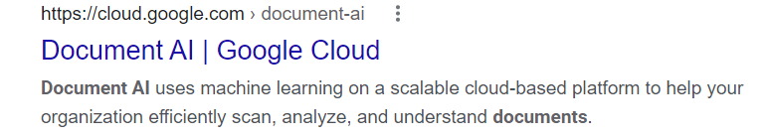
Text to Speech
Machine translation
Automatic Transcription
Text generation
Understanding search queries
Document search

Slide 6
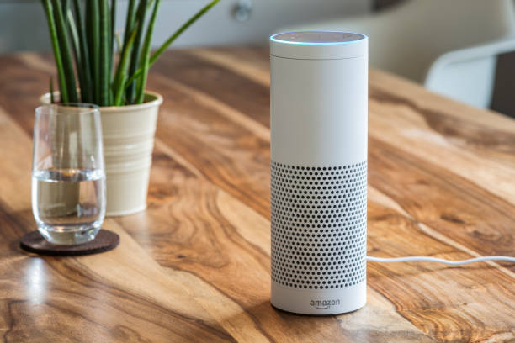
*Try It: Use a Smart Assistant
Directions:
Use Google Assistant in Chrome Browser
Or
Use speech input to Google search
or
*Ask Alexa or Siri what the weather is outside. (Teacher smartphone)
or
*Use speech input to Google translate.
Notes:
The goal of this activity is to just give students a change to use a smart assistant and use voice to ask it questions.
See how well it understands it.

Slide 7

How Speech Recognition Works
https://www.youtube.com/watch?v=2RRT1YuyBCo (5 mins)
Notes:
Teacher Note:

Slide 8

Unit Overview
In this unit, we will explore
How computers understand what we say when we talk to them
How computers understand what we type into Google and other search engines
How computer translate english into other languages
How computers understand emotion or sentiment in text
Case Study on Alexa
In this unit, we will create
A program that understand sentiment
A program that can answer questions
A chatbot

Slide 9
Deeper Dives (Extensions)

Slide 10
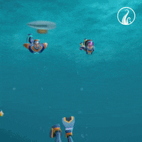
Deeper Dives
What sorts of things can Alexa or Siri understand? What are their limitations?
How does Google translate work?

Slide 11

Text Generation - How computers generate stories
https://youtu.be/gcHkxP9adiM (1 min - short) (7 mins full)

Slide 12

Text to Speech - Daisy Bell - First Singing Computer
https://youtu.be/41U78QP8nBk (1.5 mins)

Slide 13


Case Studies*
Bullying a girl named Alexa- Parents of children called Alexa challenge Amazon
Risk of some features - IS ALEXA SAFE FOR KIDS?
Rude kids?/ privacy concerns? - Are smart speakers really safe for children?
Conversation complexity/Jeopardising teaching professions? - Is Amazon Alexa harmful to children’s educational development?
Wrong/incomplete answers, discourage critical thinking - Parents say using Alexa to entertain kids comes with problems

